Slide 1
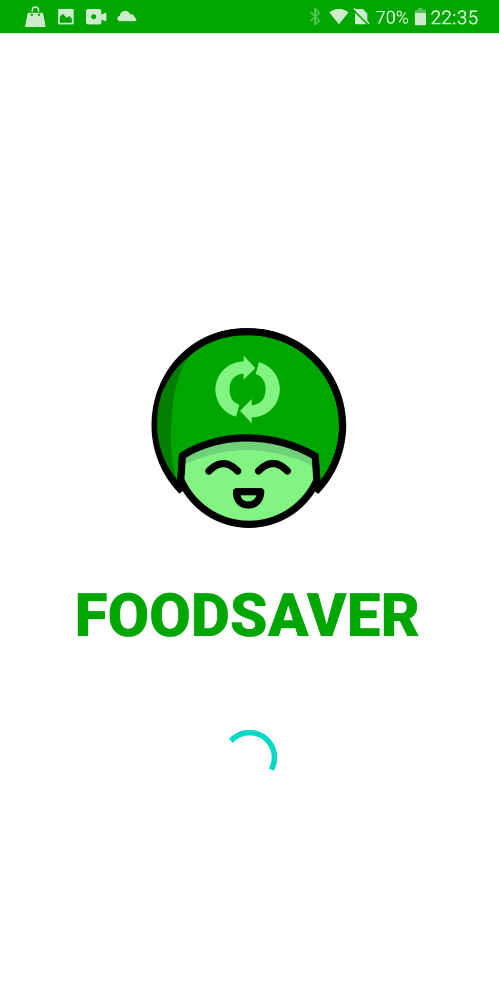

FOODSAVER

Slide 2
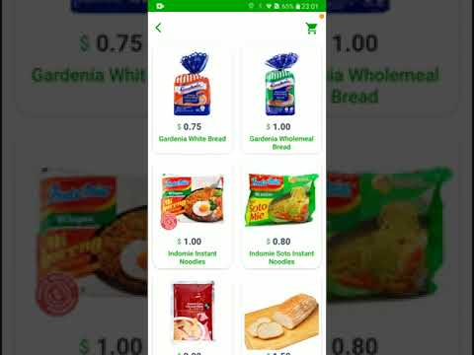

Slide 3

SPLASH PAGE
Splash Page with jingle and animation

Slide 4
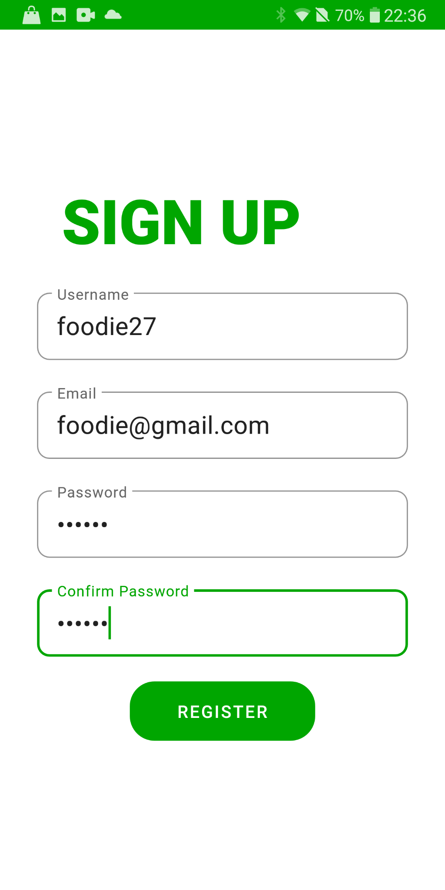
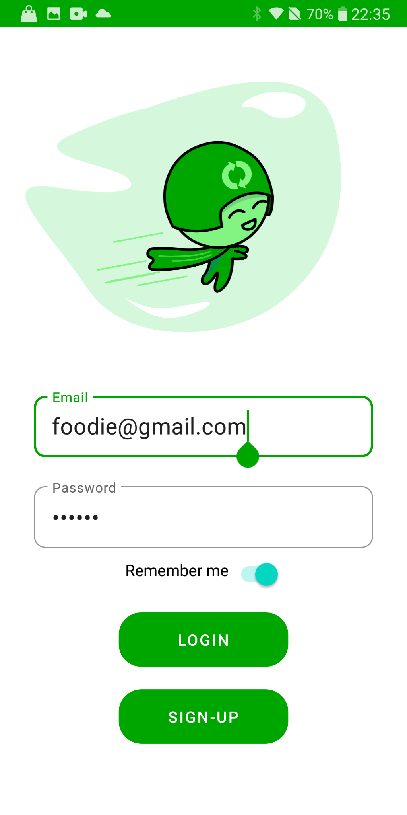
LOGIN
User can register for a brand new account and login to their account via the login page
Clicking remember me stores the email and password which allows for convenient future access

Slide 5

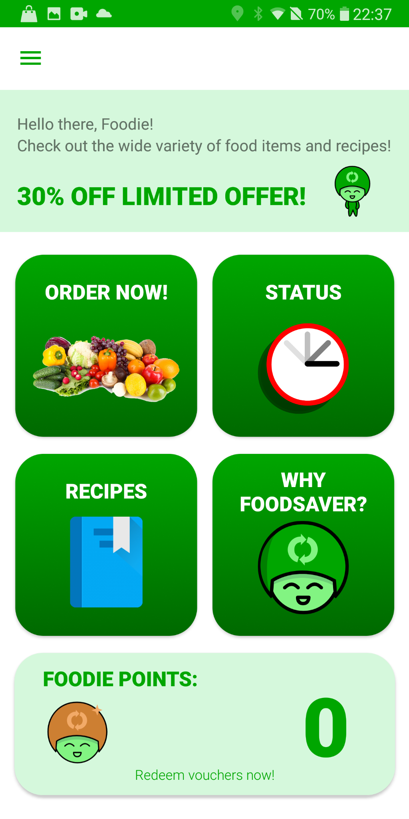
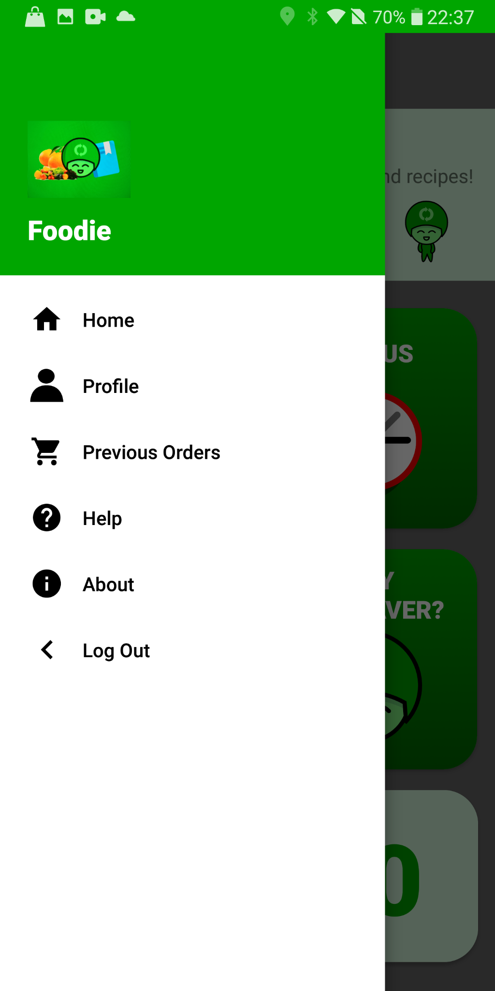
HOME
View banner for new announcements
Access the main menu using the hamburger icon
Various cards for access to different functions

Slide 6

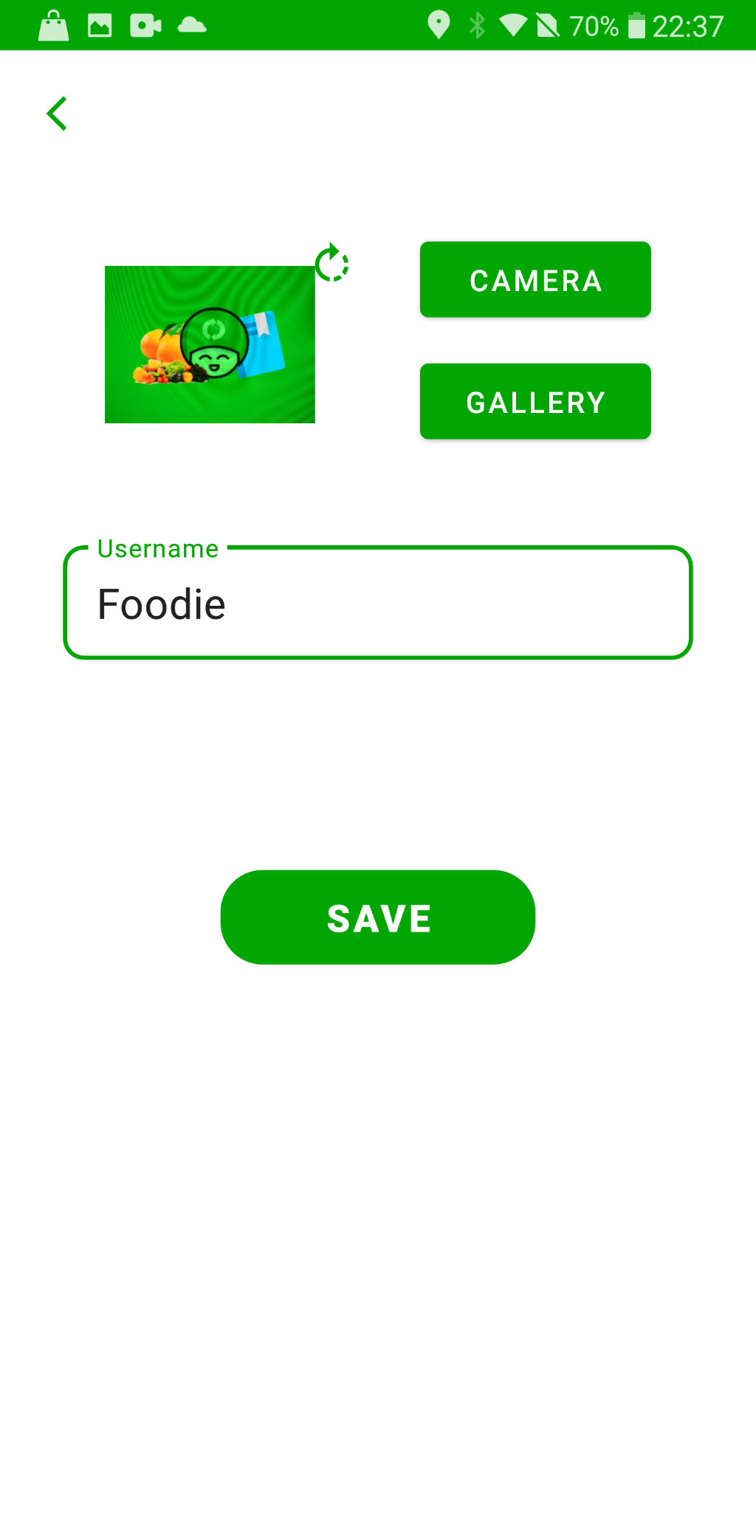
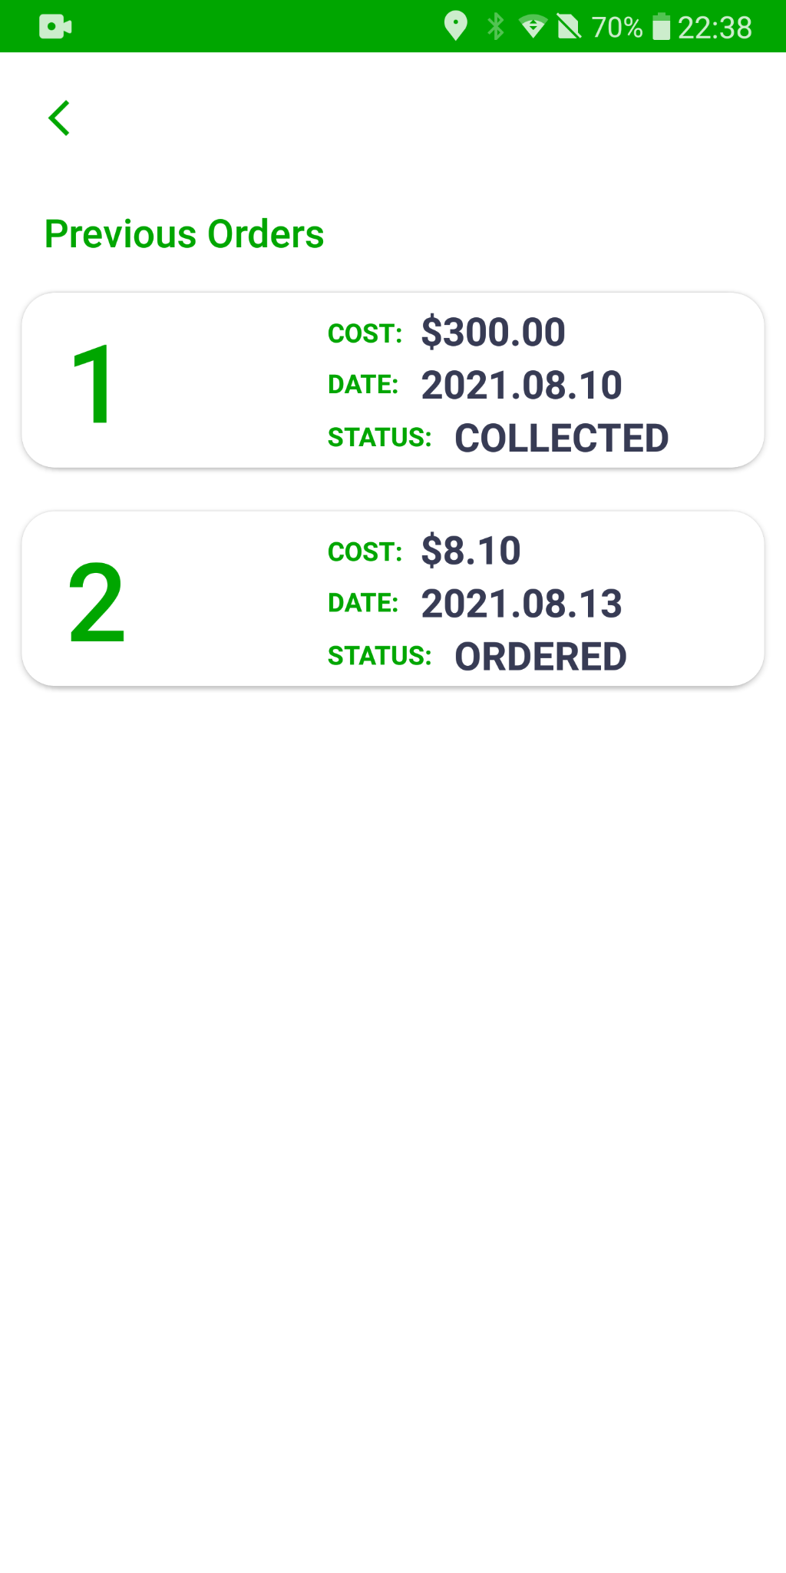
MAIN MENU
Profile: Change profile picture and username
Previous Orders: View the date, cost and status of past orders with live update from Firestore

Slide 7
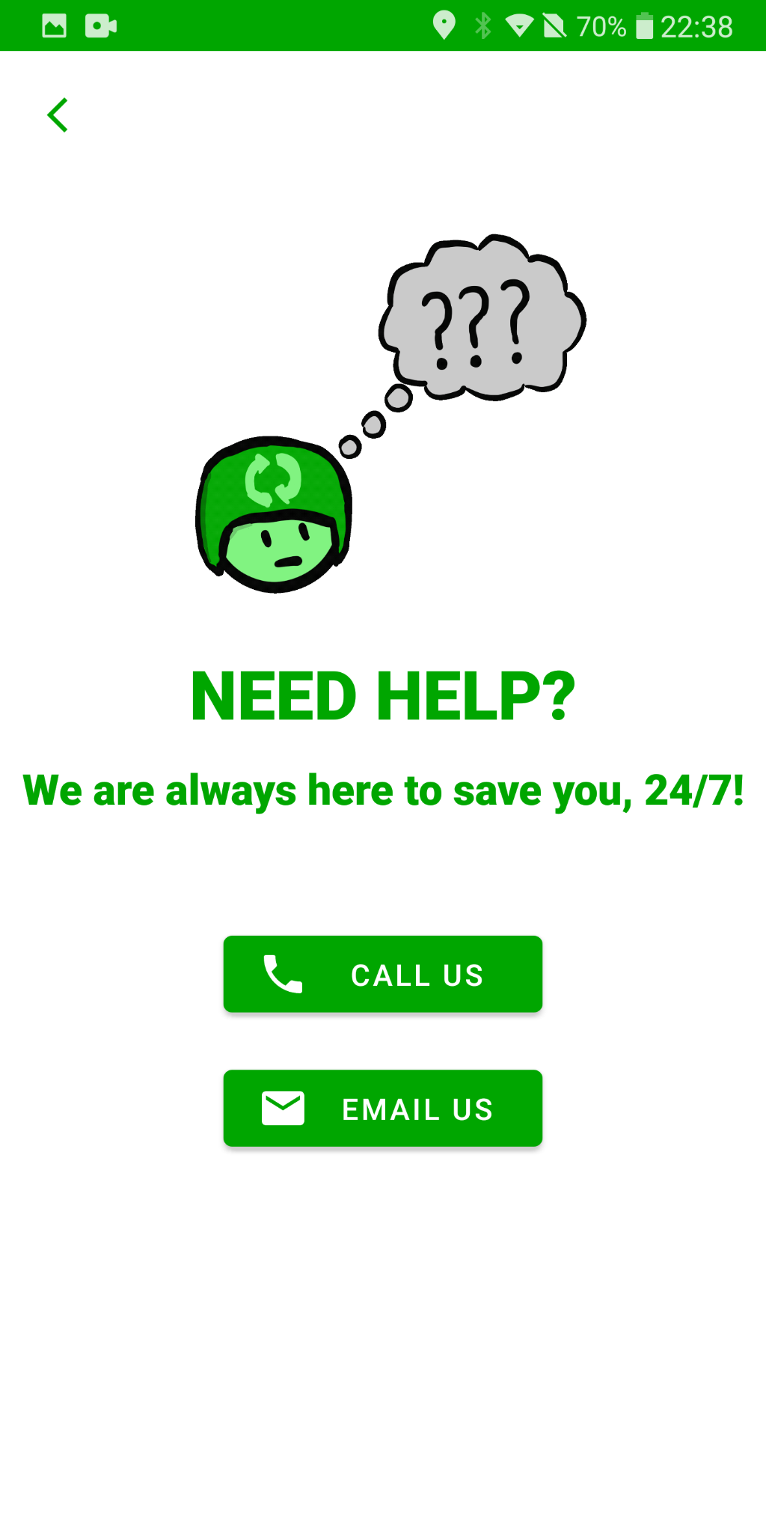
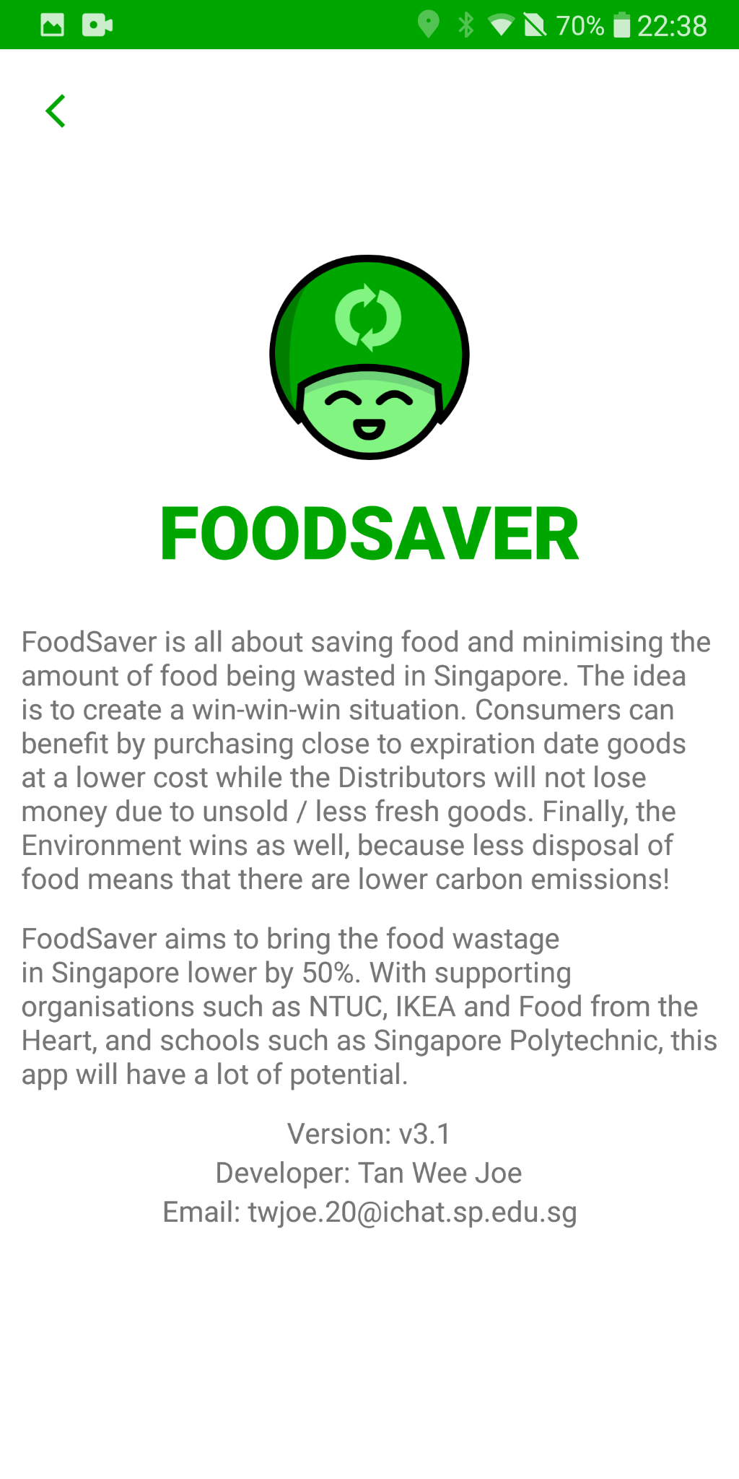
MAIN MENU
Help:
Call FoodSaver staff directly via the call function or Email the staff through the email function
About: Details about the app
Logout: Log out of the application

Slide 8

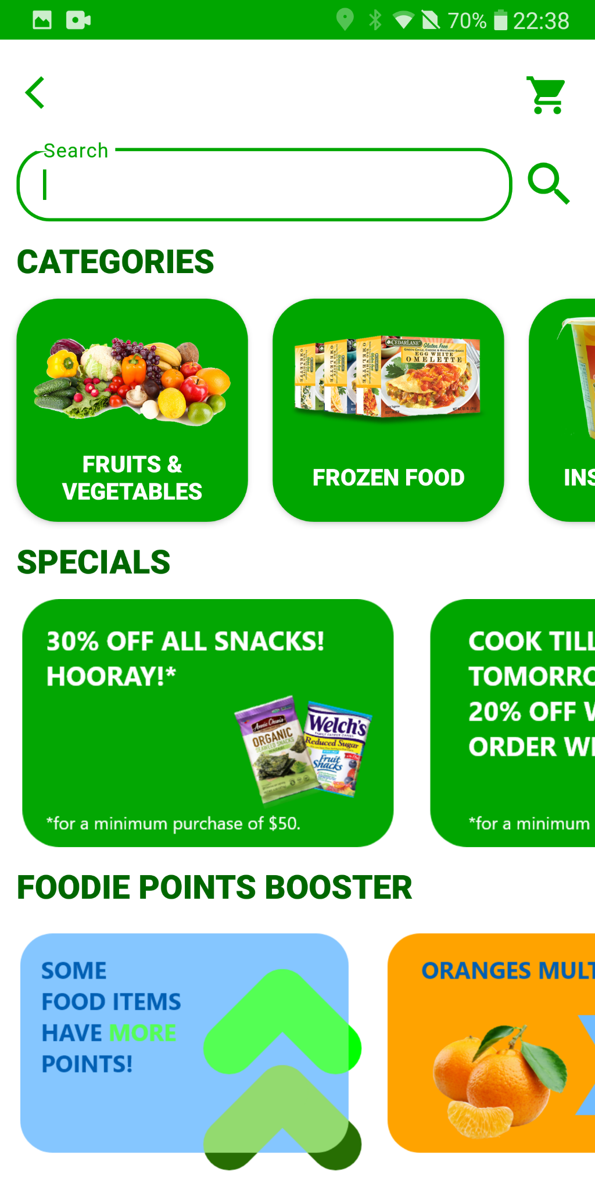
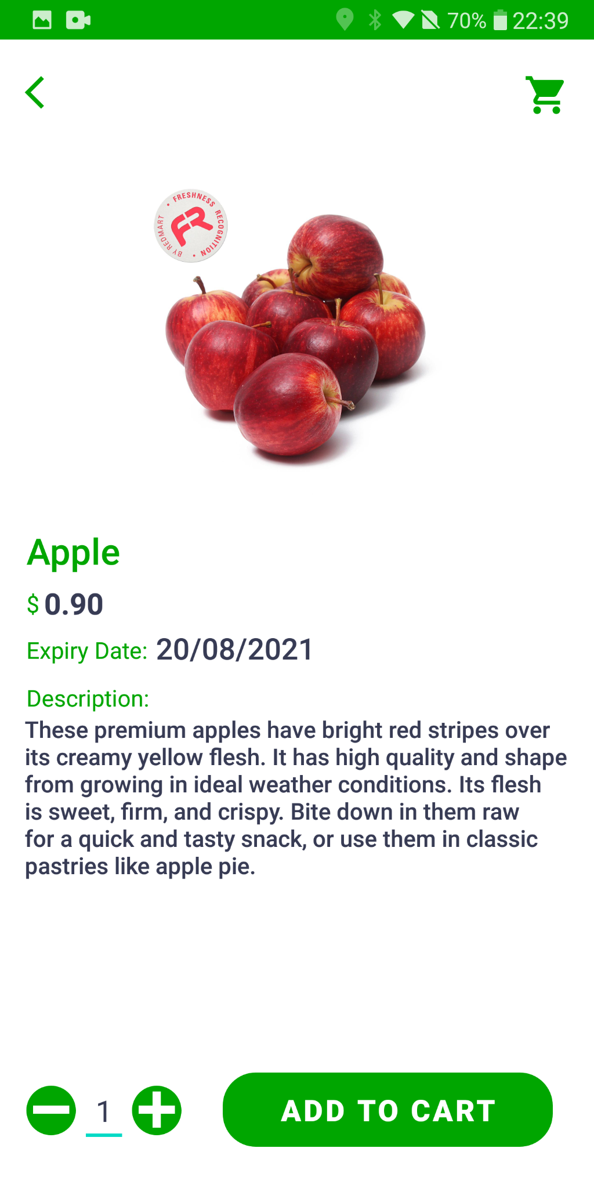
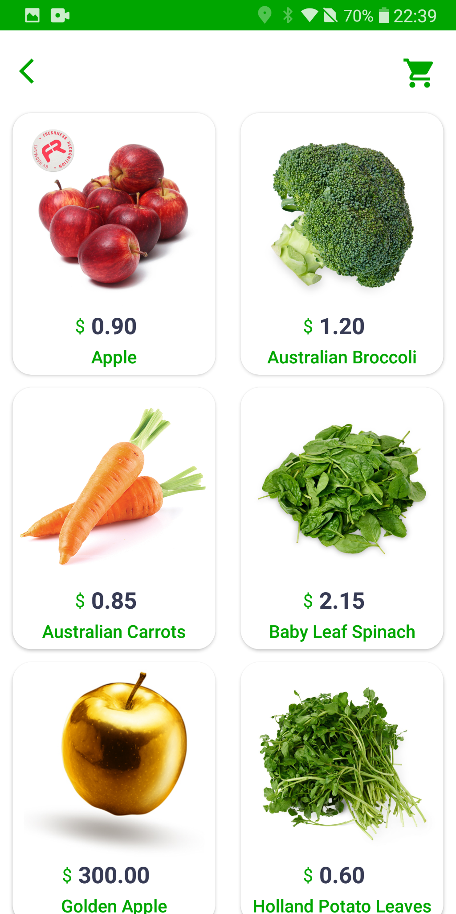
ORDER
User can view available categories and select their food items here via the search function
Item can be added to cart, updated or removed from cart

Slide 9


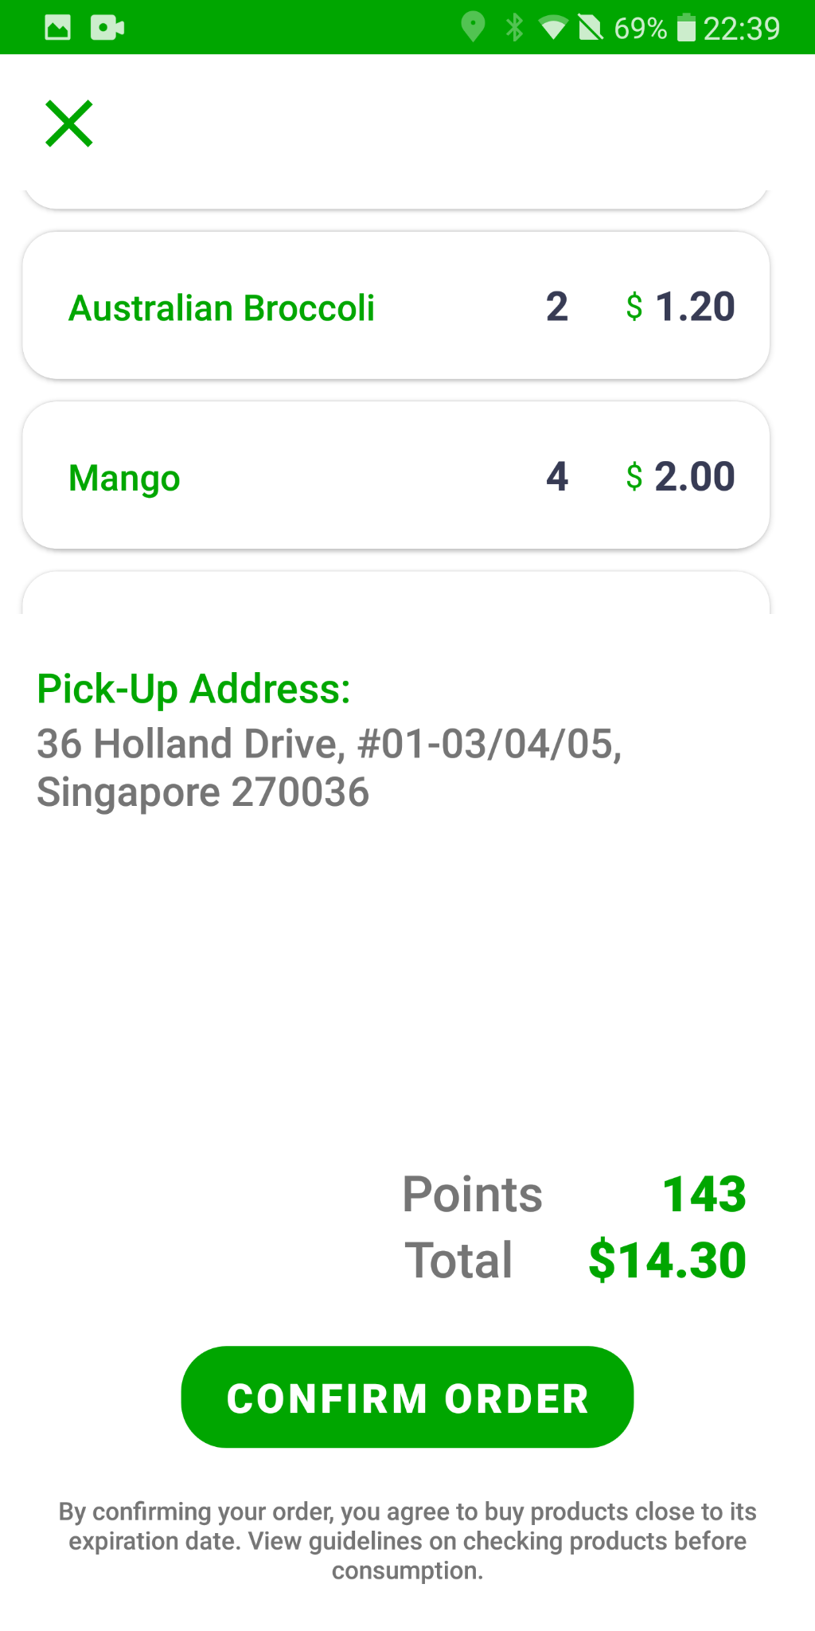
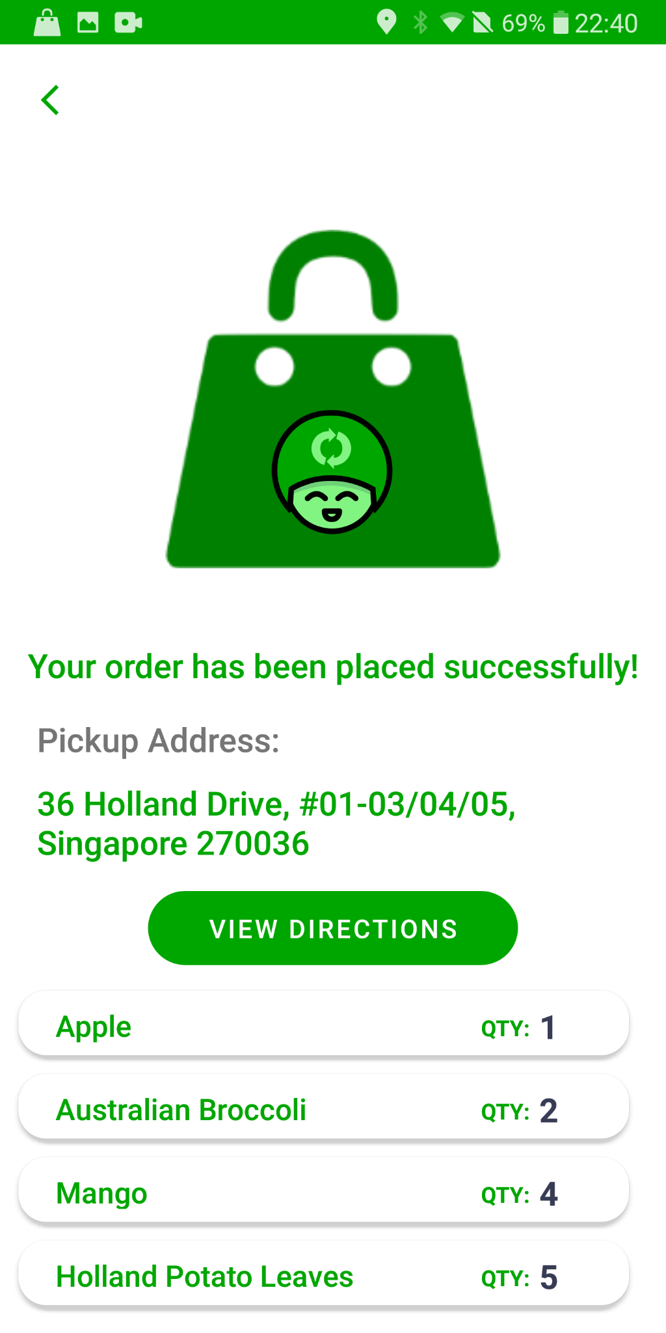
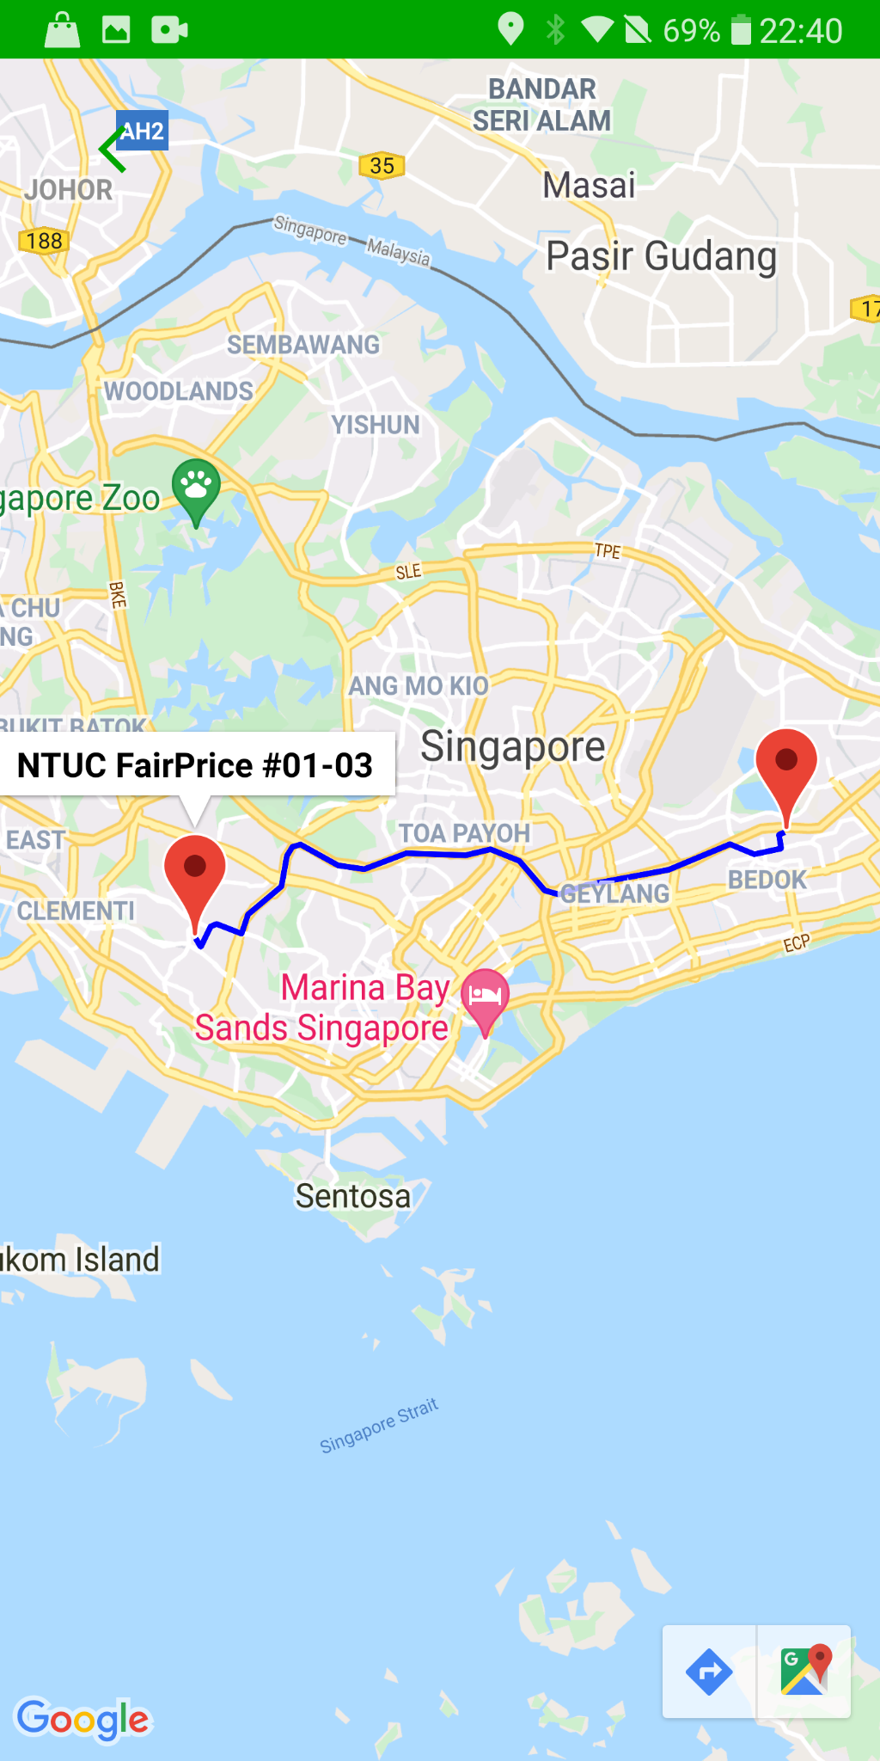
CART
STATUS
The list of food items in the cart is displayed, along with the points and total cost
View status of the order (Ordered/Collected)
Notification will be sent upon marked as collected

Slide 10


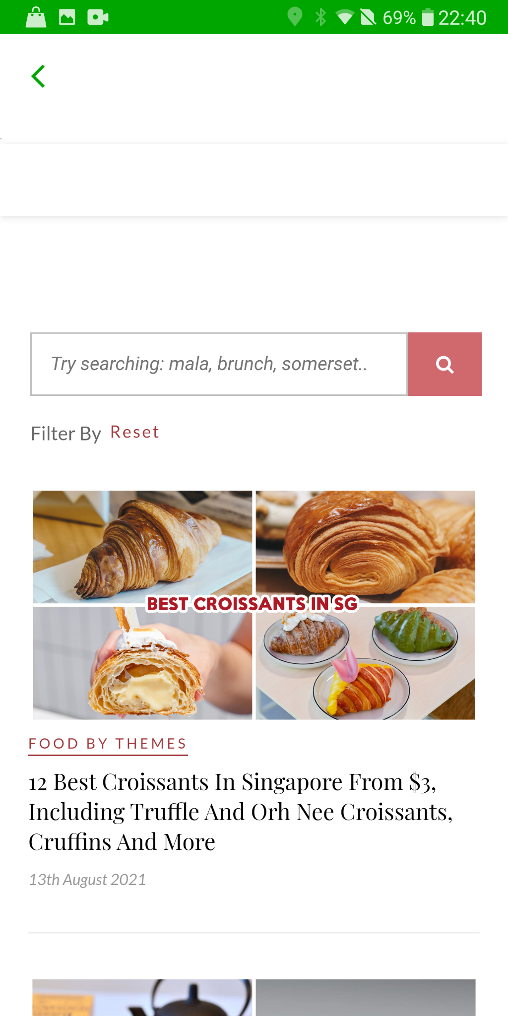
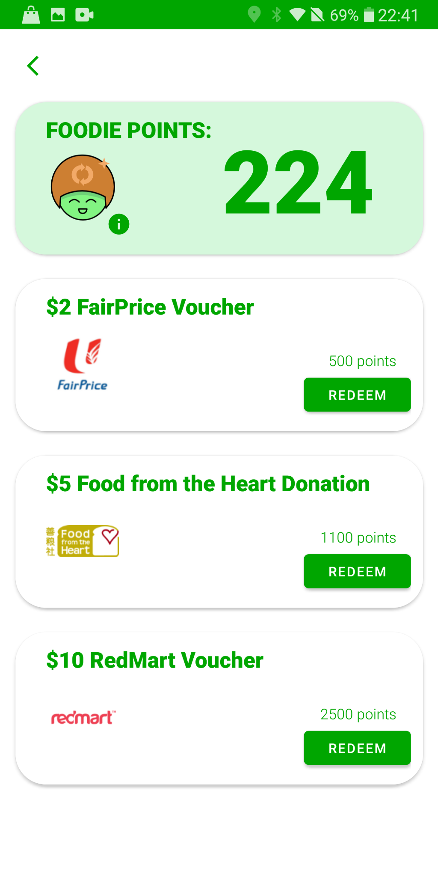
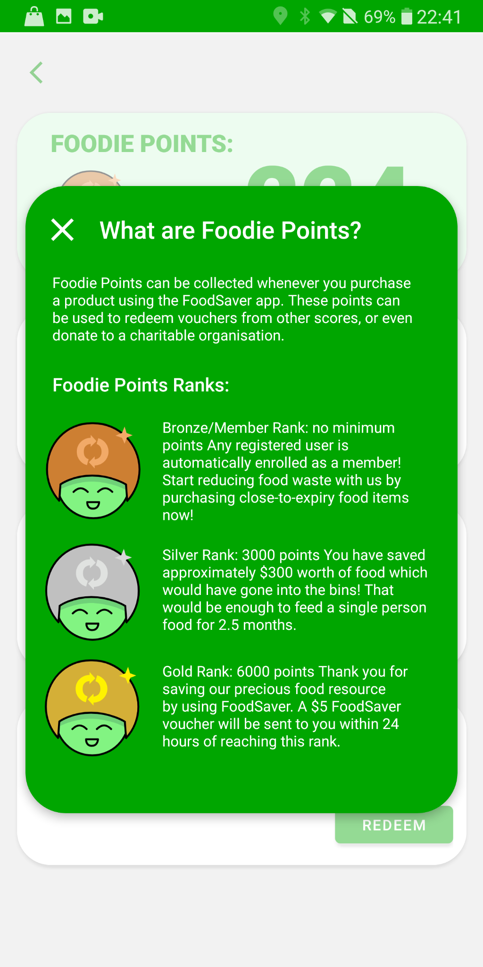
RECIPES
POINTS
Webview of a list of recipes from another website is displayed here
Redeem points for vouchers and user can view their Foodie Points level here

Slide 11




WHY FOODSAVER?
FoodSaver can help Singapore to reduce the amount of food wastage and provide benefits to both consumers and distributors.

